Slide 1
PROBLEM STATEMENT
A Microfinance Institution (MFI) is an organization that offers financial services to low income populations. MFS becomes very useful when targeting especially the unbanked poor families living in remote areas with not much sources of income. The Microfinance services (MFS) provided by MFI are Group Loans, Agricultural Loans, Individual Business Loans and so on.
Many microfinance institutions (MFI), experts and donors are supporting the idea of using mobile financial services (MFS) which they feel are more convenient and efficient, and cost saving, than the traditional high-touch model used since long for the purpose of delivering microfinance services. Though, the MFI industry is primarily focusing on low income families and are very useful in such areas, the implementation of MFS has been uneven with both significant challenges and successes.
Today, microfinance is widely accepted as a poverty-reduction tool, representing $70 billion in outstanding loans and a global outreach of 200 million clients.
We are working with one such client that is in Telecom Industry. They are a fixed wireless telecommunications network provider. They have launched various products and have developed its business and organization based on the budget operator model, offering better products at Lower Prices to all value conscious customers through a strategy of disruptive innovation that focuses on the subscriber.
They understand the importance of communication and how it affects a person’s life, thus, focusing on providing their services and products to low income families and poor customers that can help them in the need of hour.
They are collaborating with an MFI to provide micro-credit on mobile balances to be paid back in 5 days. The Consumer is believed to be defaulter if he deviates from the path of paying back the loaned amount within the time duration of 5 days. For the loan amount of 5 (in Indonesian Rupiah), payback amount should be 6 (in Indonesian Rupiah), while, for the loan amount of 10 (in Indonesian Rupiah), the payback amount should be 12 (in Indonesian Rupiah).
The sample data is provided to us from our client database. It is hereby given to you for this exercise. In order to improve the selection of customers for the credit, the client wants some predictions that could help them in further investment and improvement in selection of customers.

Slide 2
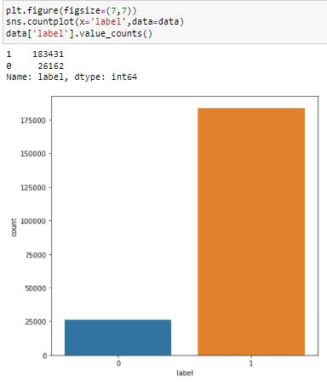
label
As per above observation, 1 = 183431 users paid back the credit amount within 5 days of issuing the loan however 0 = 26162 users did not pay back the credit amount within 5 days of issuing the loan

Slide 3
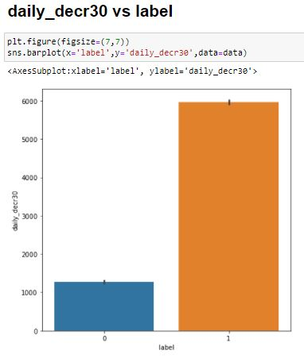
Daily_decr30 vs label
As per observation, Daily amount spent from main account, averaged over last 30 days (in Indonesian Rupiah) for 1 = 6000 however Daily amount spent from main account, averaged over last 30 days (in Indonesian Rupiah) for 0 = approx. 1300

Slide 4
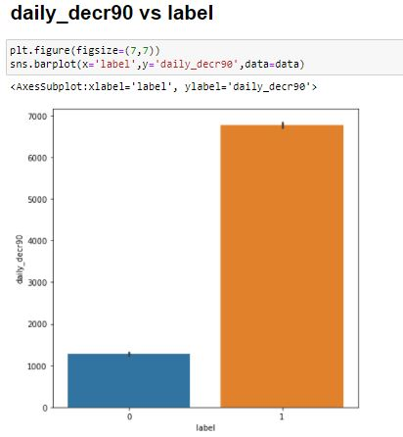
daily_decr90 vs label
As per observation, Daily amount spent from main account, averaged over last 90 days (in Indonesian Rupiah) for 1 = approx. 7000 however Daily amount spent from main account, averaged over last 90 days (in Indonesian Rupiah) for 0 = approx. 1300

Slide 5
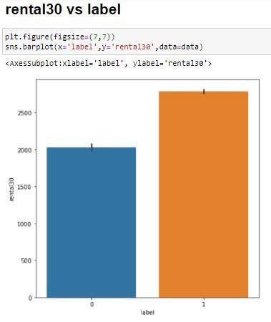
rental30 vs label
As per above observation, 1 has approx. 3000 Average main account balance over last 30 days however 0 has 2000 Average main account balance over last 30 days

Slide 6
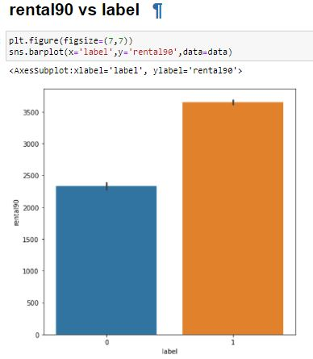
rental90 vs label
As per observation, 1 has more than 3500 Average main account balance over last 90 days however 0 has approx. 2500 Average main account balance over last 90 days

Slide 7
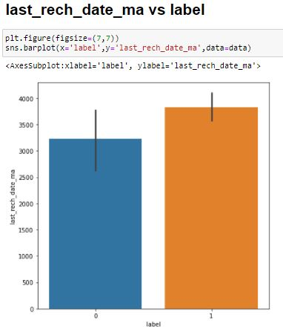
last_rech_date_ma vs label
As per observation, Number of days till last recharge of main account for 0 = 3200 however Number of days till last recharge of main account for 1 = 3800

Slide 8
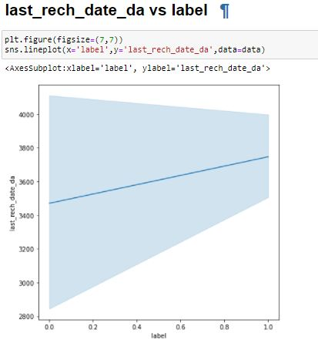
last_rech_date_da vs label
As per above observation, Number of days till last recharge of data account for 0 = 3500 however Number of days till last recharge of data account for 1 = approx. 3800

Slide 9
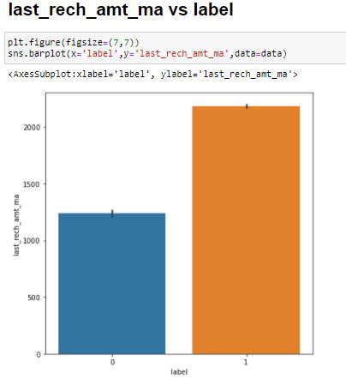
last_rech_amt_ma vs label
As per observation, Amount of last recharge of main account (in Indonesian Rupiah) for 0 = 1300 and for 1 = approx. 2500

Slide 10
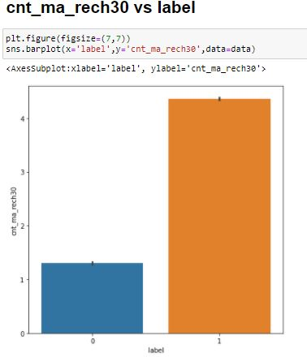
cnt_ma_rech30 vs label
As per observation, Number of times main account got recharged in last 30 days for 0 = more than 1 and for 1 = more than 4

Slide 11
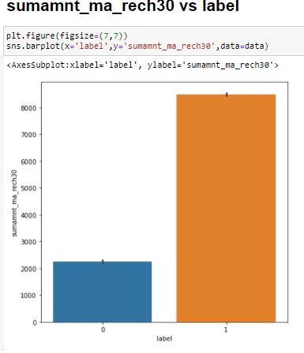
sumamnt_ma_rech30 vs label
As per above observation, Total amount of recharge in main account over last 30 days (in Indonesian Rupiah) for 0 = more than 2000 and for 1 = more than 8000

Slide 12
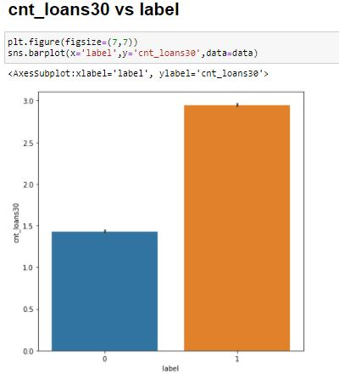
cnt_loans30 vs label
As per observation, Number of loans taken by user in last 30 days for 0 = 1.4 and for 1 = 3

Slide 13
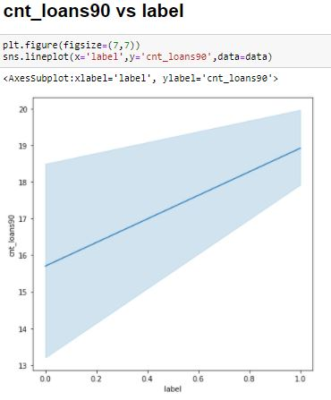
cnt_loans90 vs label
As per above observation, Number of loans taken by user in last 90 days for 0 = approx. 16 times and for 1 = 19 times

Slide 14
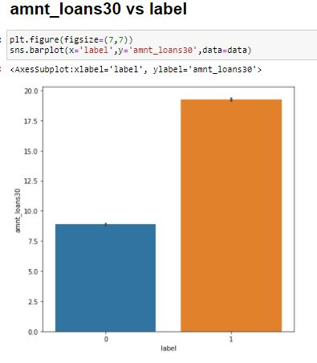
amnt_loans30 vs label
As per observation, Total amount of loans taken by user in last 30 days for 0 = approx. 10 and for 1 = approx. 20

Slide 15
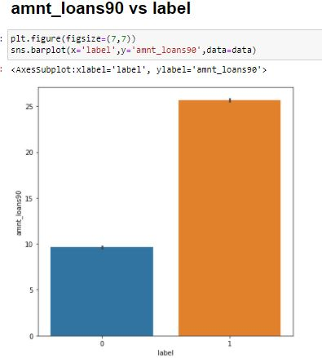
amnt_loans90 vs label
As per observation, Total amount of loans taken by user in last 90 days for 0 = 10 and for 1 = 25

Slide 16
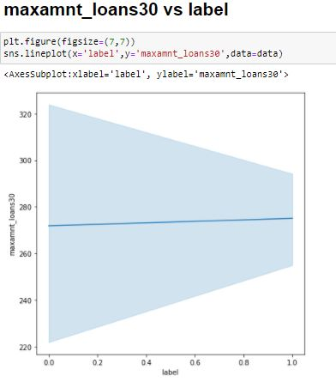
maxamnt_loans30 vs label
As per observation, maximum amount of loan taken by the user in last 30 days for 0 & 1 = 270

Slide 17
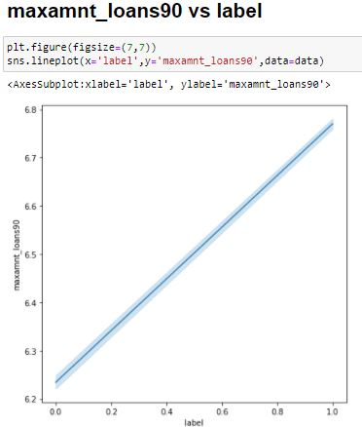
maxamnt_loans90 vs label
As per observation, maximum amount of loan taken by the user in last 90 days for 0 = 6.2 and for 1 = 6.8

Slide 18
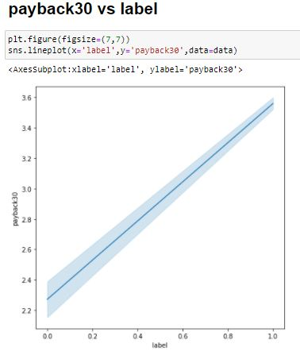
payback30 vs label
As per observation, Average payback time in days over last 30 days for 0 = 2.2 and for 1 = 3.6

Slide 19
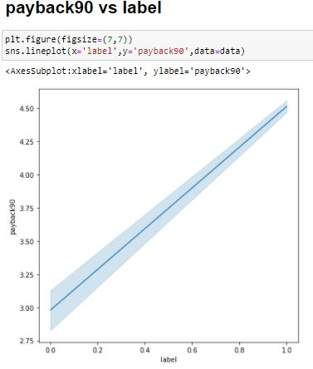
payback90 vs label
As per observation, Average payback time in days over last 90 days for 0 = 3 and for 1 = 4.5

Slide 20
Points taken into considerations before finalizing the model
Checked correlation of all the columns with Target column.
Checked Outliers of all the columns.
Checked skewness of all the columns.
Checked Normal distribution of all the columns.
Performed Outlier removal technique then came to conclusion that I will not remove outlier because I am losing almost 23% of total data.
Divided dataset into features and vector where x= features y = vector.
Divided dataset into train & test.
Used data normalization technique.

Slide 21
Used different algorithm to find best accuracy score
Used Logistic regression.
Used Decision Tree Classifier.
Used Random Forest Classifier.
Screen shots od accuracy score for all the algorithm are mentioned in another slides.

Slide 22
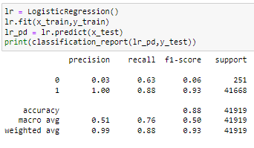
Logistic Regression
Logistic Regression
As per observation thorough logistic regression getting 88% accuracy score.

Slide 23
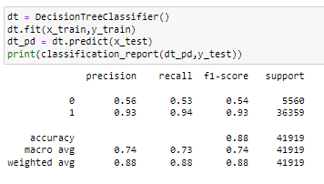
Decision Tree Classifier
As per observation through decision tree classifier getting 88% accuracy score.

Slide 24
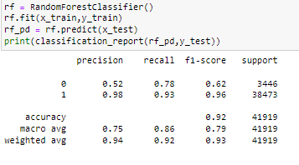
Random Forest Classifier
As per observation through Random Forest Classifier
getting 92% accuracy score.

Slide 25
Checking cross validation score

Slide 26
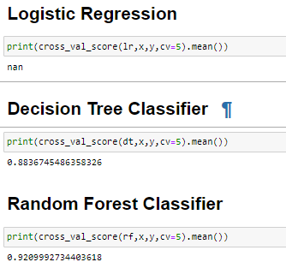
Checking cross validation score

Slide 27
As per above observation Random Forest Classifier is doing good because the difference between accuracy score and cross_val_score is lesser in comparison to other models.

Slide 28
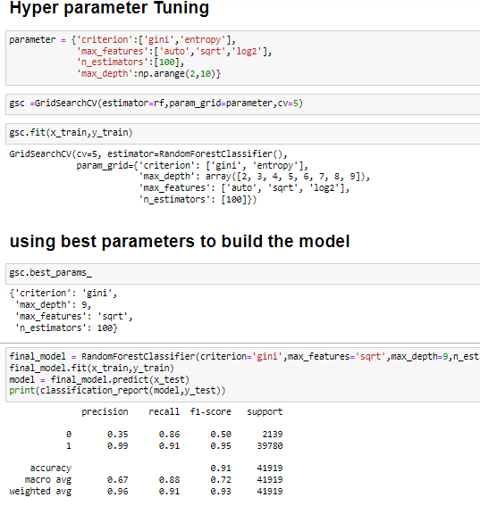
Hyper parameter Tuning

Slide 29

saving the model

